Slide 1
Data and Storage
3

Slide 2
Agenda
Binary Number System
Number Representation
Letter Representation
Voice Representation
Image and Video Representation
Bits and Bytes

Slide 3
Binary Number System
decimal
0, 1, 2, 3, 4, 5, 6, 7, 8, 9,
Notes:
In decimal, we have 10 unique digits to work with. This system is also referred to as base10. How do we use our number system?

Slide 4
Binary Number System
binary
0, 1
Notes:
In the binary number system there are only two options for each digit. Also referred to as base2 What are we more accustomed to?

Slide 5

Binary Number System
Notes:
In the binary number system there are only two options for each digit. What are we more accustomed to?

Slide 6
Binary Number System
123
Notes:
We use digits to represent powers of 10 (because we have 10 options for each digit)
What does it represent? But why?
Symbols on the screen.
rightmost digit 1s place, 10s place, 100s place.
Here we have one 100, two 10s, and 3 ones.
Thus we get what we know as one hundred twenty-three

Slide 7
Binary Number System
100 10 1
123
1X100 + 2x10 + 3x1 = 123
Notes:
We use digits to represent powers of 10 (because we have 10 options for each digit)
Here we have one 100, two 10s, and 3 ones.
Thus we get what we know as one hundred twenty-three
Decimal we know 010
10 to the 0 = 1
10 to the 1 = 10
10 to the 2 = 100

Slide 8
Binary Number System
4 2 1
000
Notes:
What if instead of powers of 10, we work with powers of 2. This is binary for 0.

Slide 9
Binary Number System
4 2 1
001
Notes:
What number is this? This is binary for 1.

Slide 10
Binary Number System
4 2 1
010
Notes:
What number is this? This is binary for 2.

Slide 11
Binary Number System
4 2 1
011
Notes:
What number is this? This is binary for 3.

Slide 12
Binary Number System
4 2 1
100
Notes:
What number is this? This is binary for 4.
carrying the number to 4th place.

Slide 13
Binary Number System
4 2 1
111
Notes:
What number is this? This is binary for 7.
How do we represent 8?
Binary digit = bits

Slide 14
4 2 1
111+1= ?
Notes:
🍐 This is a Pear Deck Text Slide
🍐 To edit the type of question, go back to the "Ask Students a Question" in the Pear Deck sidebar.

Slide 15
Binary Number System
8 4 2 1
1000
Notes:
What number is this? This is binary for 8.
Binary digit = bits

Slide 16
Binary Number System
999
100 10 1
Notes:
What number is this?
How do we represent 8?
Binary digit = bits

Slide 17
Binary Number System
1000 100 10 1
1000
Notes:
What number is this?
How do we represent 8?
Binary digit = bits

Slide 18
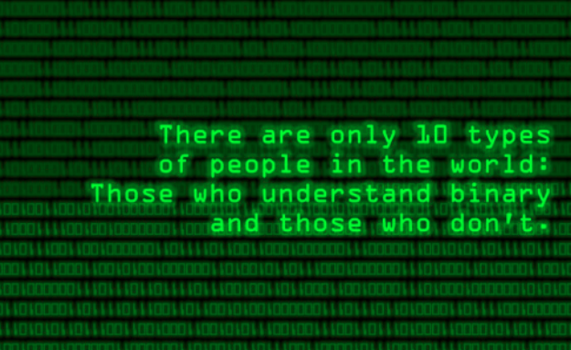

Slide 19
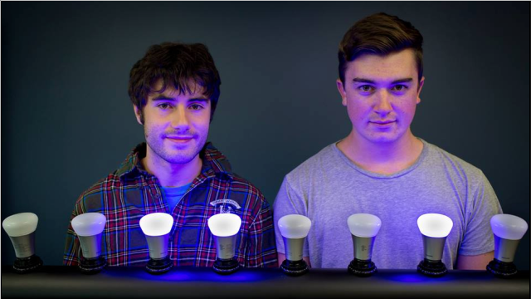
Binary Number System
Click to image:
Notes:
Click to image to go to activity!

Slide 20
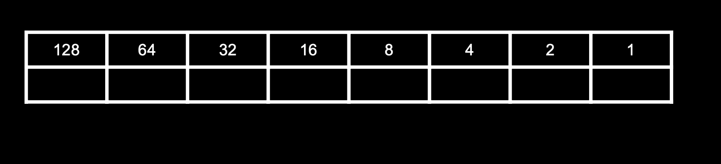
Let’s practice

Slide 21
Choose a response
Choose the binary number system representation of 14
1 1 1 0
1 0 1 0
1 0 0 0
1 1 1 1
1 0 0 1
Notes:
Story Problem
Type in a story problem, and update the answer options to suit your story.
🍐 This is a Pear Deck Multiple Choice Slide. Your current options are: A: Option A, B: Option B, C: Option C, D: Option D, E: Option E,
🍐 To edit the type of question or choices, go back to the "Ask Students a Question" in the Pear Deck sidebar.

Slide 22

How about 50?
110010
110111
110101
111101
Notes:
Odd One Out
Insert four images that have different things in common, and let students debate which one doesn’t belong.
🍐 This is a Pear Deck Draggable™ Slide.
🍐 To edit the type of question, go back to the "Ask Students a Question" in the Pear Deck sidebar.

Slide 23
Binary Number System
1001
Notes:
🍐 This is a Pear Deck Number Slide
🍐 To edit the type of question, go back to the "Ask Students a Question" in the Pear Deck sidebar.

Slide 24
Binary Number System
11010 = ? in decimal
Notes:
🍐 This is a Pear Deck Number Slide
🍐 To edit the type of question, go back to the "Ask Students a Question" in the Pear Deck sidebar.
What number is this?

Slide 25
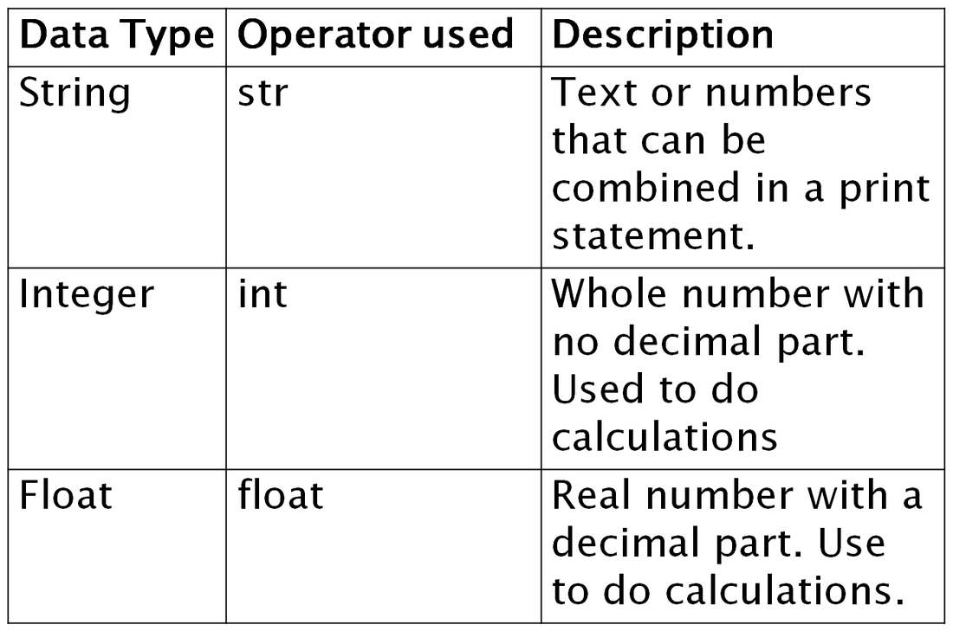
Number Representation
Numbers are represented as integers.
Notes:
Now to look at what we can do with binary. One example of abstraction from how computers process binary numbers is ASCII or American Standard Code for Information Interchange.

Slide 26
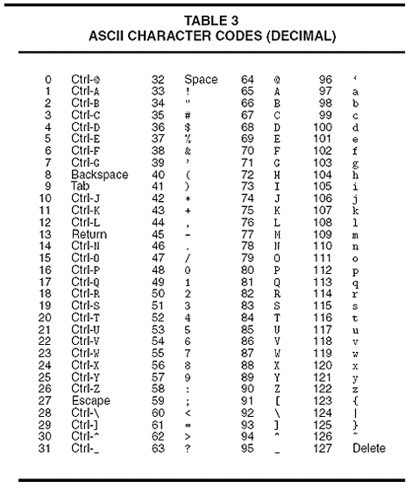
Letter Representation
ASCII: American Standard Code for Information Interchange
Notes:
Now to look at what we can do with binary. One example of abstraction from how computers process binary numbers is ASCII or American Standard Code for Information Interchange.

Slide 27
Letter Representation
ASCII: American Standard Code for Information Interchange
7 bits ---> 128 letters/symbols
Notes:
Now to look at what we can do with binary. One example of abstraction from how computers process binary numbers is ASCII or American Standard Code for Information Interchange.

Slide 28
Letter Representation
ASCII: American Standard Code for Information Interchange
_
_
_
72
73
33
Notes:
Now to look at what we can do with binary. One example of abstraction from how computers process binary numbers is ASCII or American Standard Code for Information Interchange.

Slide 29
Letter Representation
ASCII: American Standard Code for Information Interchange
_
_
_
H
72
73
33
Notes:
Now to look at what we can do with binary. One example of abstraction from how computers process binary numbers is ASCII or American Standard Code for Information Interchange.

Slide 30
Letter Representation
ASCII: American Standard Code for Information Interchange
_
_
_
H
I
72
73
33
Notes:
Now to look at what we can do with binary. One example of abstraction from how computers process binary numbers is ASCII or American Standard Code for Information Interchange.

Slide 31
Letter Representation
ASCII: American Standard Code for Information Interchange
_
_
_
H
I
!
72
73
33
Notes:
Now to look at what we can do with binary. One example of abstraction from how computers process binary numbers is ASCII or American Standard Code for Information Interchange.

Slide 32
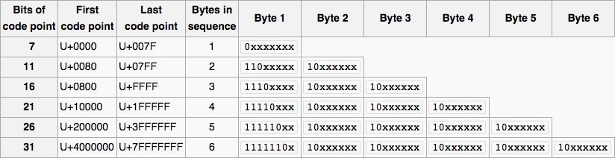
Letter Representation
Unicode:
Notes:
Now to look at what we can do with binary. One example of abstraction from how computers process binary numbers is ASCII or American Standard Code for Information Interchange.
Unicode is also known as UTF-8 or the Universal Alphabet
Ordered set of over a million characters
Unicode is not software, it is a standard
It is a 16-bit encoding standard

Slide 33
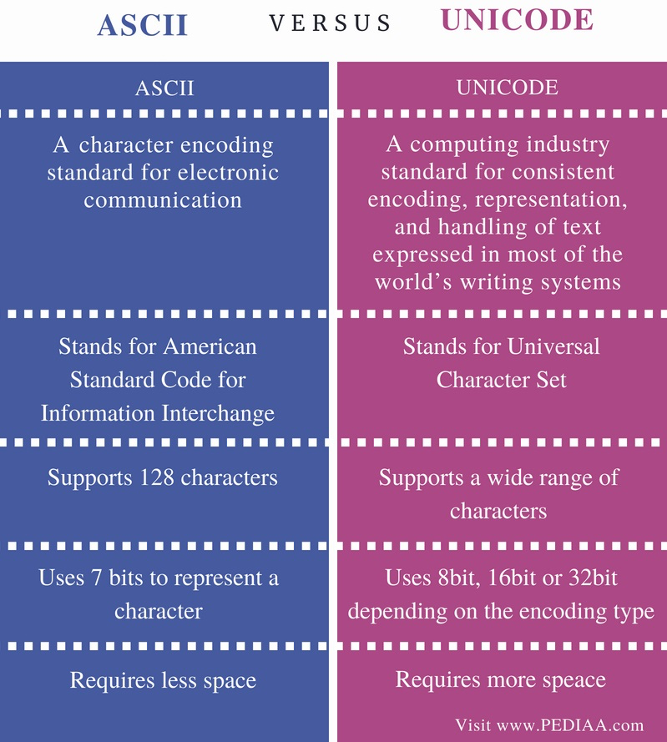
Letter Representation
Notes:
Now to look at what we can do with binary. One example of abstraction from how computers process binary numbers is ASCII or American Standard Code for Information Interchange.

Slide 34



Letter Representation
Unicode:
U+1F606 U+1F69F U+1F63F
Notes:
Now to look at what we can do with binary. One example of abstraction from how computers process binary numbers is ASCII or American Standard Code for Information Interchange.

Slide 35
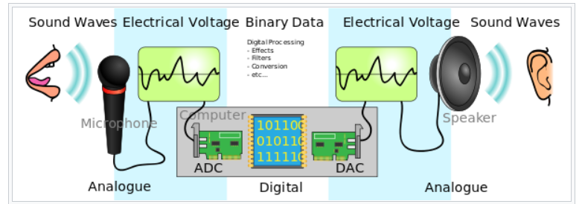
Voice Representation
Notes:
Now to look at what we can do with binary. One example of abstraction from how computers process binary numbers is ASCII or American Standard Code for Information Interchange.
Audio signals are represented in waves
A binary value is assigned to the amplitude each wave at particular time intervals
Sound is analog
ADC - Analog-to-digital Converter
DAC - Digital-to-analog Converter
The greater the sampling frequency, the higher the quality of the sound

Slide 36
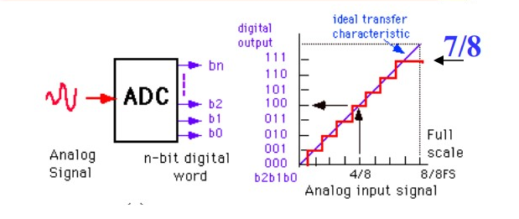
Voice Representation
Notes:
In ADCs, two factors determine the accuracy of the digital value that captures the analog signal
Quantization level, or bit rate
Sampling rate
Bit rate determines the resolution of digitized output
Graphic shows a 3-bit ADC converting analog signal

Slide 37

RGB (Red, Green Blue)
Image and Video Representation
72 | 73 | 33
Notes:
Binary thinks in terms of 1 and 0
LEDs - Red, Green and Blue (RGB)
Three main colors the eye takes in - known as the additive primary colors
Combined to create different colors
Red, Green and Blue shades are assigned a number from 0 to 255 - each shade is assigned an 8-bit number

Slide 38
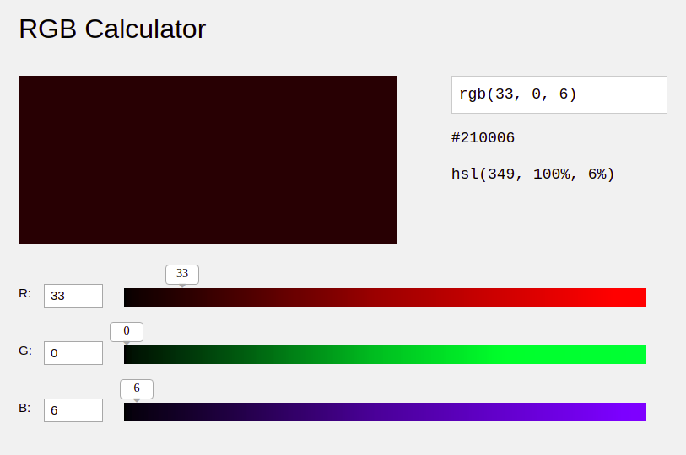

Image and Video Representation
Notes:
🍐 This is a Pear Deck Multiple Choice Slide. Your current options are: A: R:131 G:181 B:122, B: R:225 G:126 B:184, C: R: 160 G:78 B:17,
🍐 To edit the type of question or choices, go back to the "Ask Students a Question" in the Pear Deck sidebar.
But what if we uses these numbers to represent colors, namely levels of red, green, and blue (RGB).
Click to this page and go to web site, then changing RGB values from where the arrows indicate, find the color which is at the screen.

Slide 39
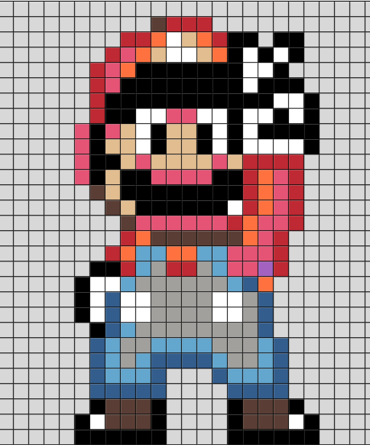
Image and Video Representation
Notes:
Now to look at what we can do with binary. One example of abstraction from how computers process binary numbers is ASCII or American Standard Code for Information Interchange.

Slide 40
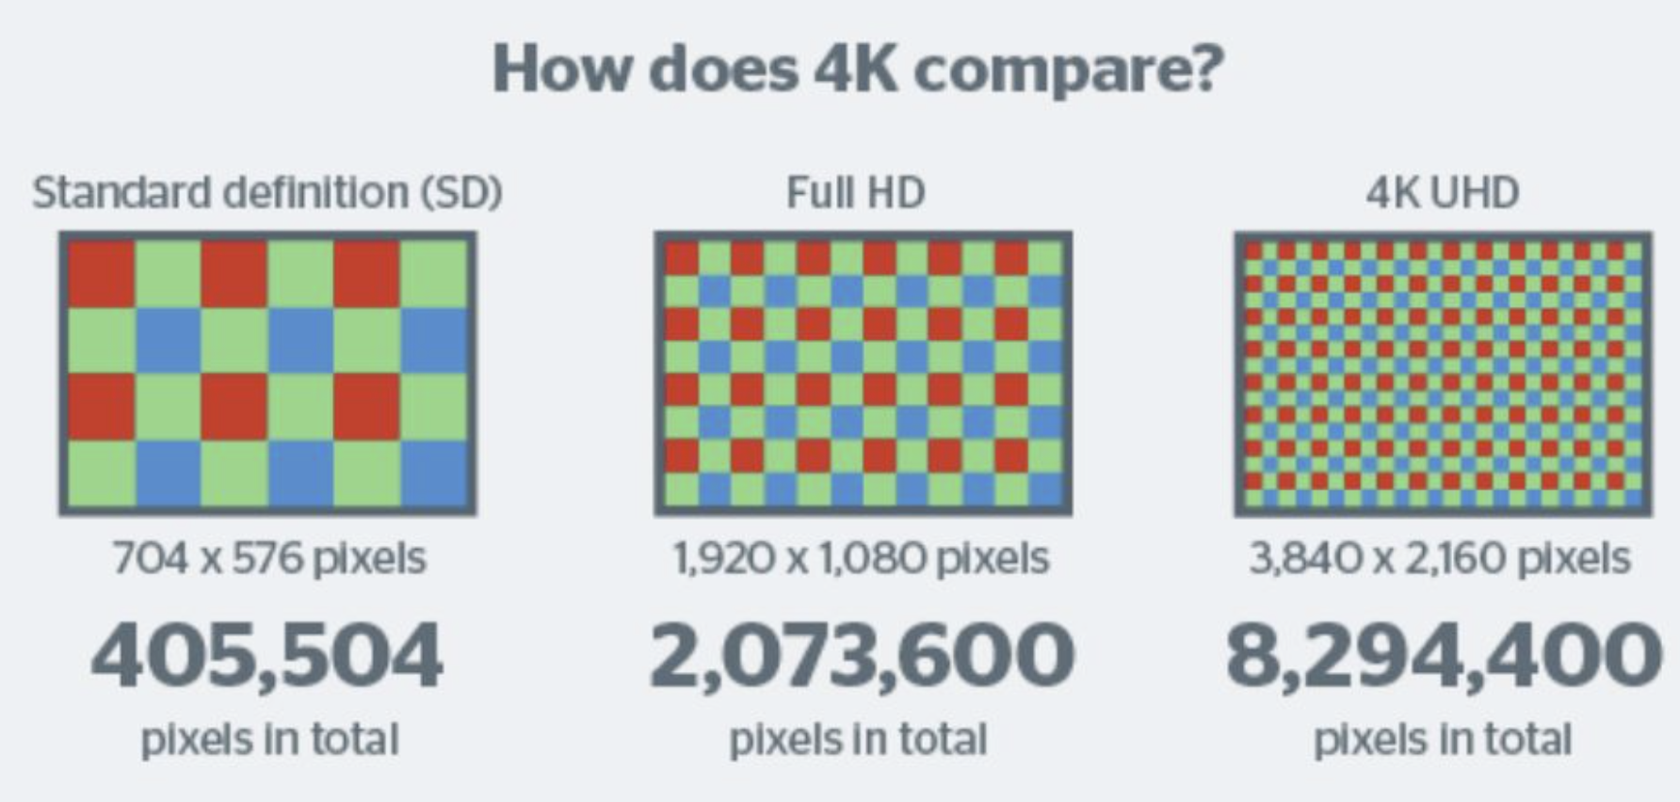
Image and Video Representation
Notes:
Now to look at what we can do with binary. One example of abstraction from how computers process binary numbers is ASCII or American Standard Code for Information Interchange.

Slide 41



How well did you like this section?
Notes:
Temperature Check
Get a sense for how well your lesson resonated with your students, or how engaged they were.
🍐 This is a Pear Deck Draggable™ Slide.
🍐 To edit the type of question, go back to the "Ask Students a Question" in the Pear Deck sidebar.

Slide 42
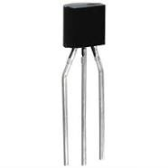
Bits and Bytes
Bit
0/1
true/false
yes,no
Notes:
Bit is a portmanteau of binary digit. As such, a bit can be either 1 or 0… etc
Under the hood, on a computer's CPU are transistors. These transistors have two states, off, represented by the bit 0, and…

Slide 43
Bits and Bytes
Byte
8 bits
Notes:
Perhaps a more common measure of memory is the byte (think gigabytes).
Why 8 bits? What's special about 8?
Only represent one alphanumerical character
(For image) These transistors can be either on or off to represent different information.
Imagine binary is similar to a light switch
1 represents on
0 represents off
If computers used the decimal system, there would be a combination of 10 different states, requiring the computer to work harder to interpret them all.
With binary, the computer only has to interpret two states, on and off

Slide 44
Bits and Bytes
Kilobyte
1000 bytes
8000 bits
Notes:
Kilo means 1000, so it follows that a kilobyte is 1000 bytes… well…
A byte is 8-bits, so 1,000 bytes is 8,000 bits, or a kilobyte

Slide 45
Bits and Bytes
Kilobyte
1000 1024 bytes
8000 8192 bits
Notes:
So it's not exactly 1000 bytes… Why is it 1024 though?

Slide 46
Bits and Bytes
Kilobyte
2¹⁰ bytes
Notes:
So it's not exactly 1000 bytes… Why is it 1024 though?
1,000 is not a power of 2. The nearest equivalent is 2 to the power of 10, which equals 1024. The kilo in binary uses the nearest figure to the kilo in decimal, which is 1024.

Slide 47

Bits and Bytes
Notes:
Think of a docx file. This would typically be measured in KB.

Slide 48
Bits and Bytes
Megabyte
2¹⁰ kilobytes
2²⁰ bytes
1024 kilobytes
Notes:
1 million bytes
1 thousand kilobytes
2 to the 10th power is 1,024
2 to the 20th power is 1,048,576

Slide 49

Bits and Bytes
Notes:
MP3s for example.

Slide 50
Bits and Bytes
Gigabyte
2¹⁰ megabytes
2²⁰ kilobytes
2³⁰ bytes
1024 megabytes

Slide 51

Bits and Bytes
Notes:
Like the storage on a device like this, a flash drive.

Slide 52
Bits and Bytes
Terabyte
2¹⁰ gigabytes
2²⁰ megabytes
2³⁰ kilobytes
2⁴⁰ bytes
1024 gigabytes

Slide 53
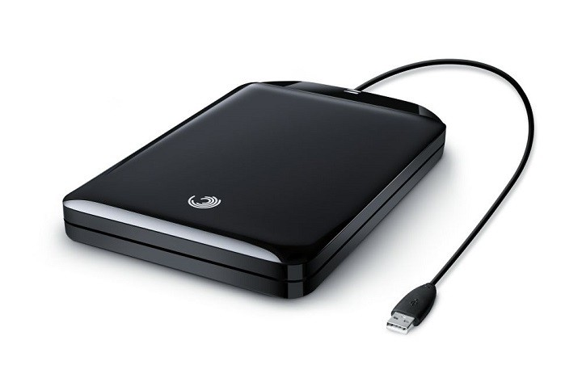
Bits and Bytes
Notes:
Like the storage on this external drive.
1 bit -- a marble full of water
1 byte -- 1/8 cup water
1 kilobyte -- 9 gallons of water
1 megabyte -- an above ground swimming pool full of water
1 gigabyte -- a football field sized-pool of water, three feet deep
1 terabyte -- a football field sized-pool of water, half a mile deep

Slide 54

bytEgyptian pyramids
Let’s write to bits and bytes pyramid.
……….
……………………….
……………………….
………………………..
(1024 Byte)
Notes:
Step Up to the Solution
Identifying the necessary steps and pieces of information needed to come to an answer is an important thinking skill. Practicing this skill can also help students see learning as a journey with missteps, deviations, and scenic routes. Help students practice by regularly asking them to identify the information, tasks, and processes along the way to solving a particular problem.
🍐 This is a Pear Deck Drawing Slide
🍐 To edit the type of question, go back to the "Ask Students a Question" in the Pear Deck sidebar.

Slide 55

Notes:
Kahoot url: CF Review https://create.kahoot.it/details/a631b609-2c84-4d21-a9fe-cbe5f8ca47f1

Slide 56


Circle how you are feeling:
Notes:
Emotion Check
Use this template to prompt students to check in with themselves. This will also help you gauge the mood in your classroom and notice any students who might attention.
🍐 This is a Pear Deck Drawing Slide
🍐 To edit the type of question, go back to the "Ask Students a Question" in the Pear Deck sidebar.

Slide 57

THANKS!
Any questions?
You can find us at:
@Jamil
jamil@clarusway.com
@Tomy
tomy@clarusway.com

